Slide 1
Identifying Similar Cities for Restaurant Chain Expansion
ANKIT CHAUBAL
MAR 2020

Slide 2
Business Statement
Our Client, a Leading Restaurant Chain in Los Angeles, wants to expand its business globally and is looking for suitable cities
They want to identify cities which are similar to Los Angeles, so that the restaurant can be established without much changes to their core offerings

Slide 3
Data to be Used
The company has a list of 25 cities among which they want to shortlist a few for expansion
This is a CSV file consisting of City name and Country Name of 25 cities.

Slide 4
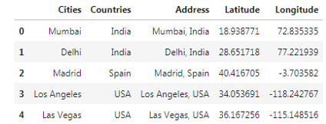
Data Processing- Step 1
We first generate a new field for Address, by combining City and Country name
Using the same, we fetch Co-ordinates of each city

Slide 5
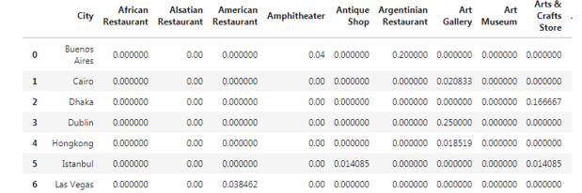
Data Processing -2
Using Foursquare API, we explore nearby venues in each city and get necessary venue details- Venue Name/Co-ordinates/Category
We identify top 10 most common venues and perform one hot encoding to get data set for K Means Clustering

Slide 6
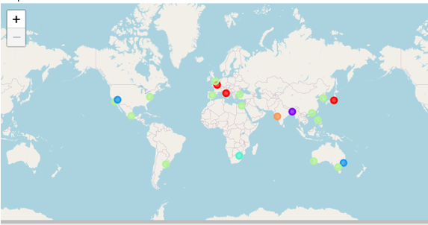
Data Analysis
We analyze the data using kmeans clustering and generate the clusters
We visualize the clusters on a map and identify cities similar to Los Angeles

Slide 7
Results and Recommendations
There are 13 cities which are similar to Los Angeles in terms of Venues
The Restaurant Team can further analyze these 13 cities for expansion opportunities and depending upon factors such as cost/ease of business/locality identification, they can further shortlist the City for opening new Restaurant

